Slide 3
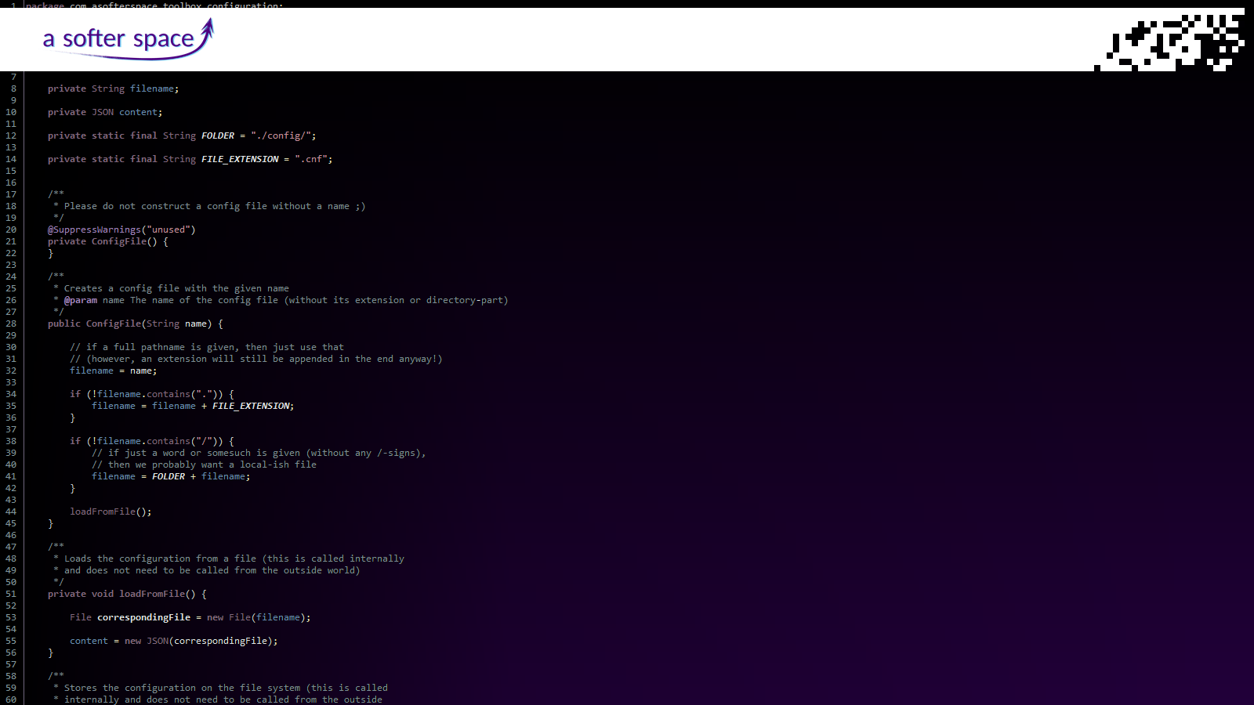

Slide 4
Founded in 2018
Located in Frankfurt, Germany
International customers (Germany, Iceland, India, Poland)

Slide 5
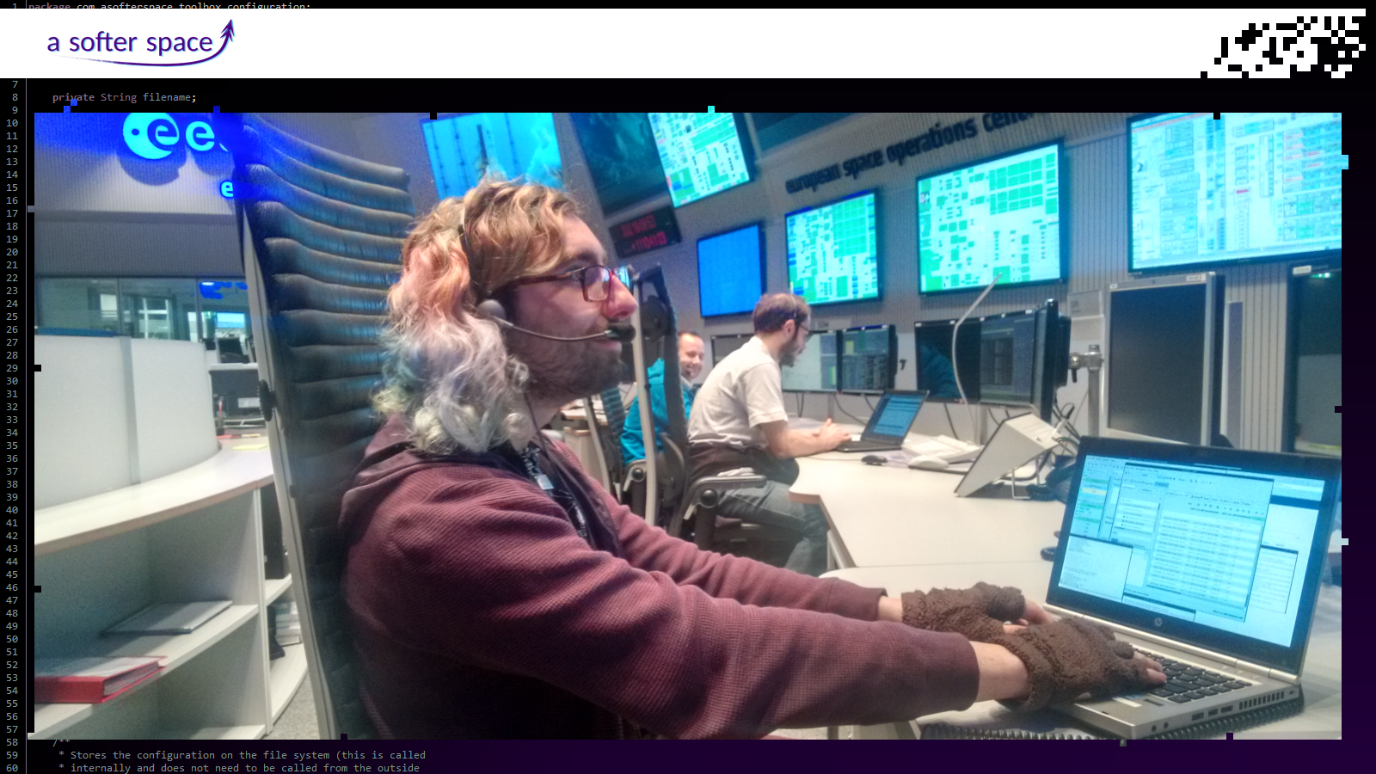

Slide 6
“A Softer Space” as we specialise on developing software for the space sector
“A Softer Space” as we specialise on developing software for the space sector
“A Softer Space” as we specialise on developing software for the space sector
“A Softer Space” as we specialise on developing software for the space sector
“A Softer Space” as we specialise on developing software for the space sector
“A Softer Space” as we specialise on developing software for the space sector
“A Softer Space” as we specialise on developing software for the space sector
“A Softer Space” as we specialise on developing software for the space sector
“A Softer Space” as we specialise on developing software for the space sector
“A Softer Space” as we specialise on developing software for the space sector
“A Softer Space” as we specialise on developing software for the space sector
“A Softer Space” as we specialise on developing software for the space sector
“A Softer Space” as we specialise on developing software for the space sector

Slide 7
Before building the next Mars colony, we also want to achieve something with our software on Earth
We therefore support scientific projects...
... and in general everything that is meaningful and helps people
Explicitly no military projects!

Slide 8
We develop:

Slide 9
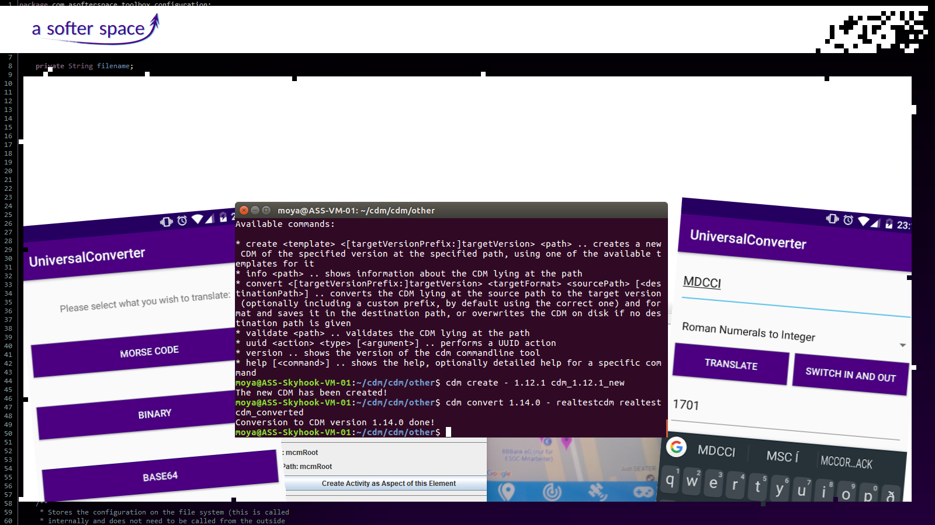
We develop:
Conventional desktop programs, web applications and apps for smartphones

Slide 10
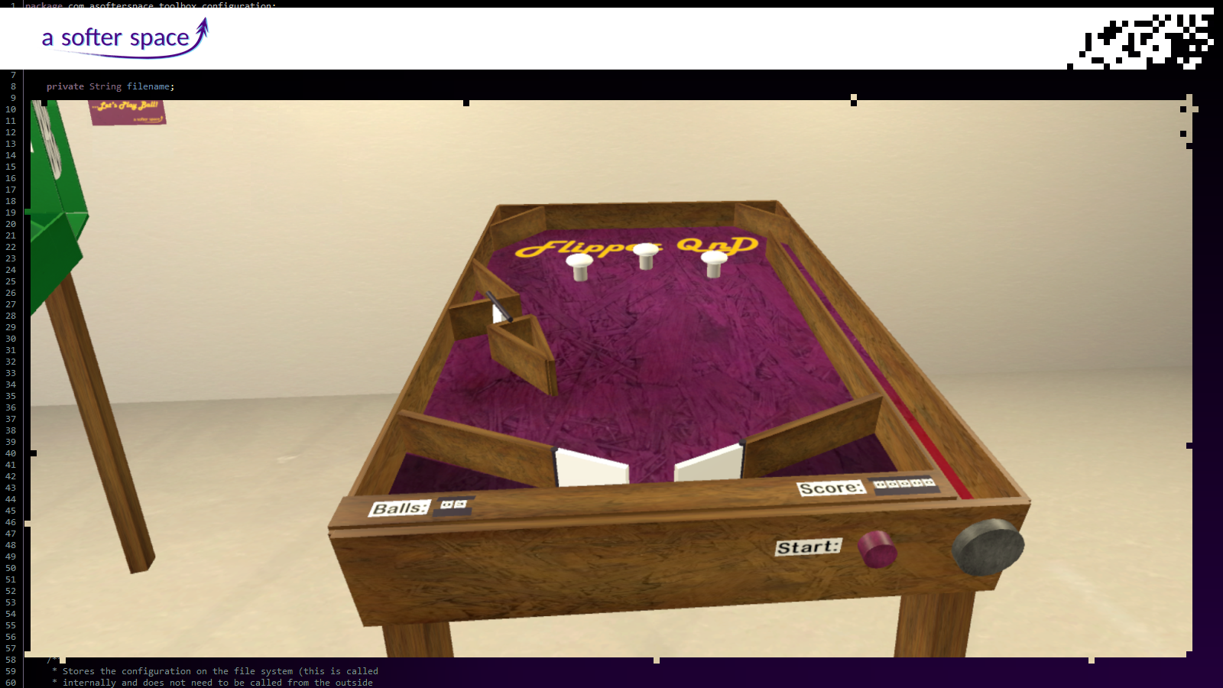
We develop:
We develop:
We develop:
We develop:
We develop:
We develop:
We develop:
We develop:
We develop:
We develop:
We develop:
We develop:
We develop:

Slide 11
We develop:
We develop:
We develop:
We develop:
We develop:
We develop:
We develop:
We develop:
We develop:
We develop:
We develop:
We develop:
We develop:
Virtual Reality applications
Virtual Reality applications
Virtual Reality applications
Virtual Reality applications
Virtual Reality applications
Virtual Reality applications
Virtual Reality applications
Virtual Reality applications
Virtual Reality applications
Virtual Reality applications
Virtual Reality applications
Virtual Reality applications
Virtual Reality applications

Slide 12
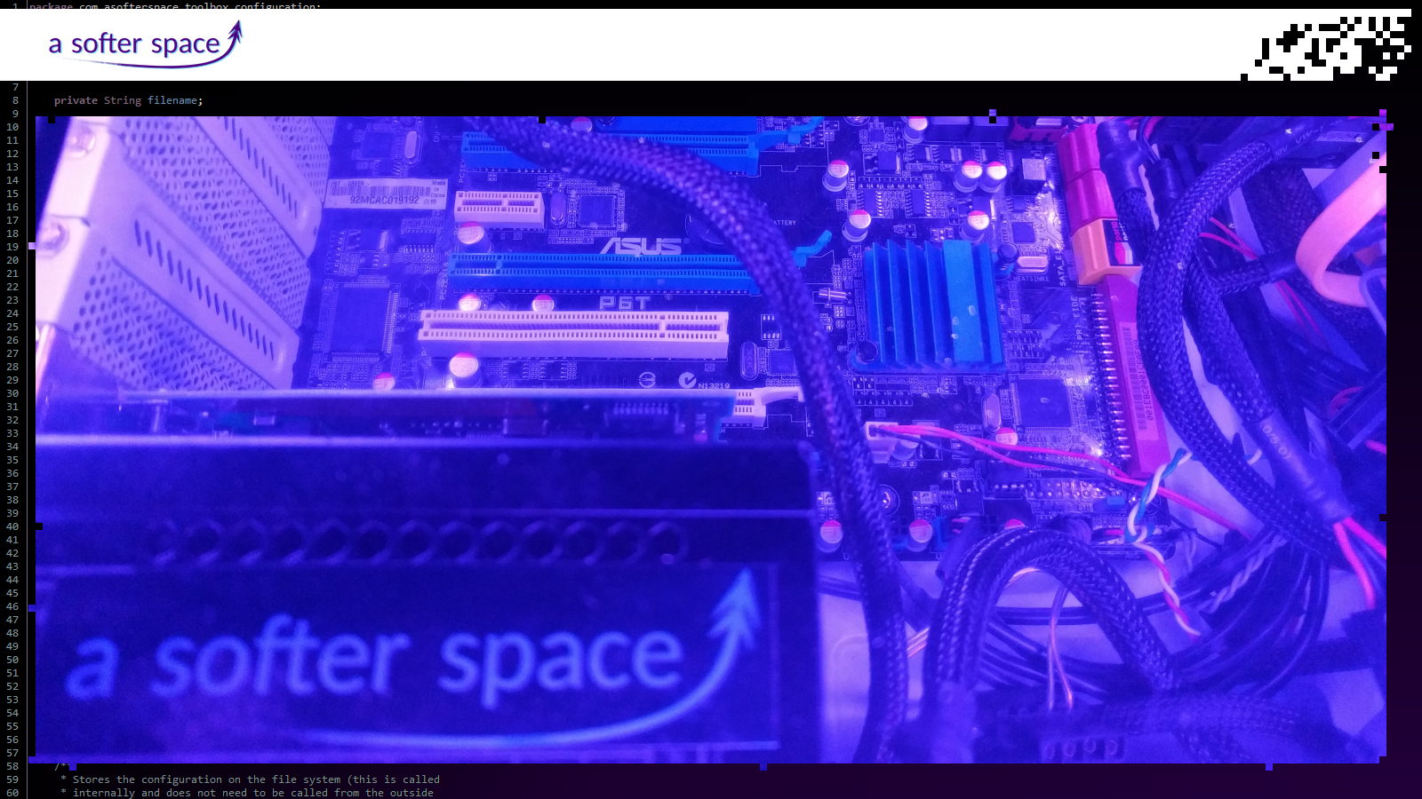
We develop:
We develop:
We develop:
We develop:
We develop:
We develop:
We develop:
We develop:
We develop:
We develop:
We develop:
We develop:
We develop:

Slide 13
We develop:
Low level program code
Interfaces for legacy systems
We develop:
Low level program code
Interfaces for legacy systems
We develop:
Low level program code
Interfaces for legacy systems
We develop:
Low level program code
Interfaces for legacy systems
We develop:
Low level program code
Interfaces for legacy systems
We develop:
Low level program code
Interfaces for legacy systems
We develop:
Low level program code
Interfaces for legacy systems
We develop:
Low level program code
Interfaces for legacy systems
We develop:
Low level program code
Interfaces for legacy systems
We develop:
Low level program code
Interfaces for legacy systems
We develop:
Low level program code
Interfaces for legacy systems
We develop:
Low level program code
Interfaces for legacy systems
We develop:
Low level program code
Interfaces for legacy systems

Slide 14
We create software in the space sector in which problems quickly become critical and which needs to work reliably for decades
This is the standard we hold ourselves to for all our products
Therefore we create well-tested software and do not blindly jump onto the latest trends...

Slide 15
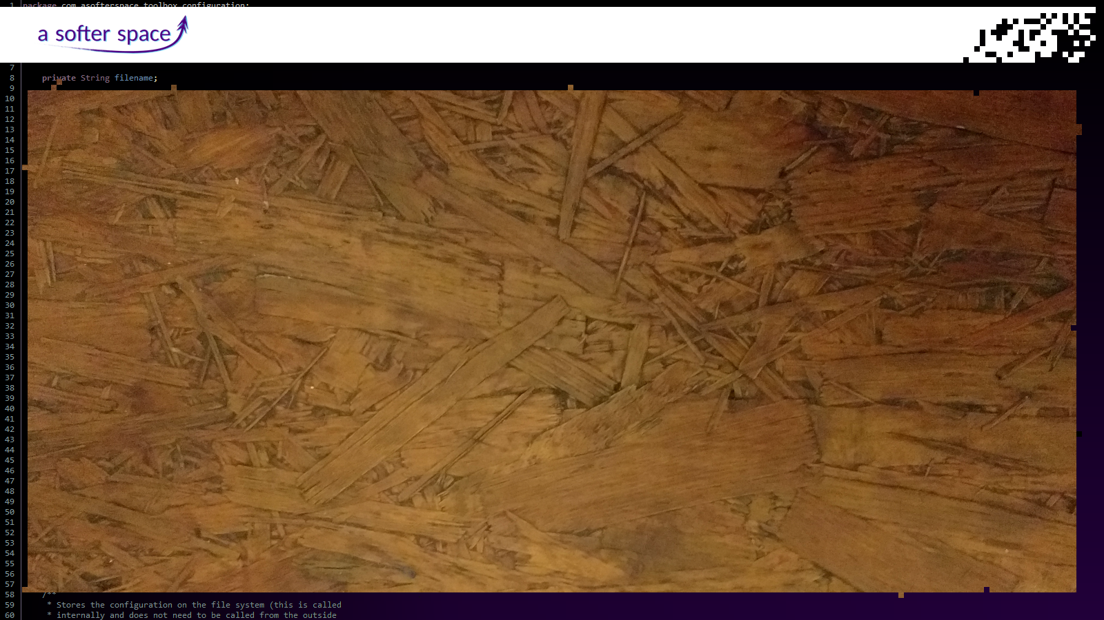
... but build reliable
“Software made from wood”
instead
... but build reliable
“Software made from wood”
instead
... but build reliable
“Software made from wood”
instead
... but build reliable
“Software made from wood”
instead
... but build reliable
“Software made from wood”
instead
... but build reliable
“Software made from wood”
instead
... but build reliable
“Software made from wood”
instead
... but build reliable
“Software made from wood”
instead
... but build reliable
“Software made from wood”
instead
... but build reliable
“Software made from wood”
instead
... but build reliable
“Software made from wood”
instead
... but build reliable
“Software made from wood”
instead
... but build reliable
“Software made from wood”
instead

Slide 16
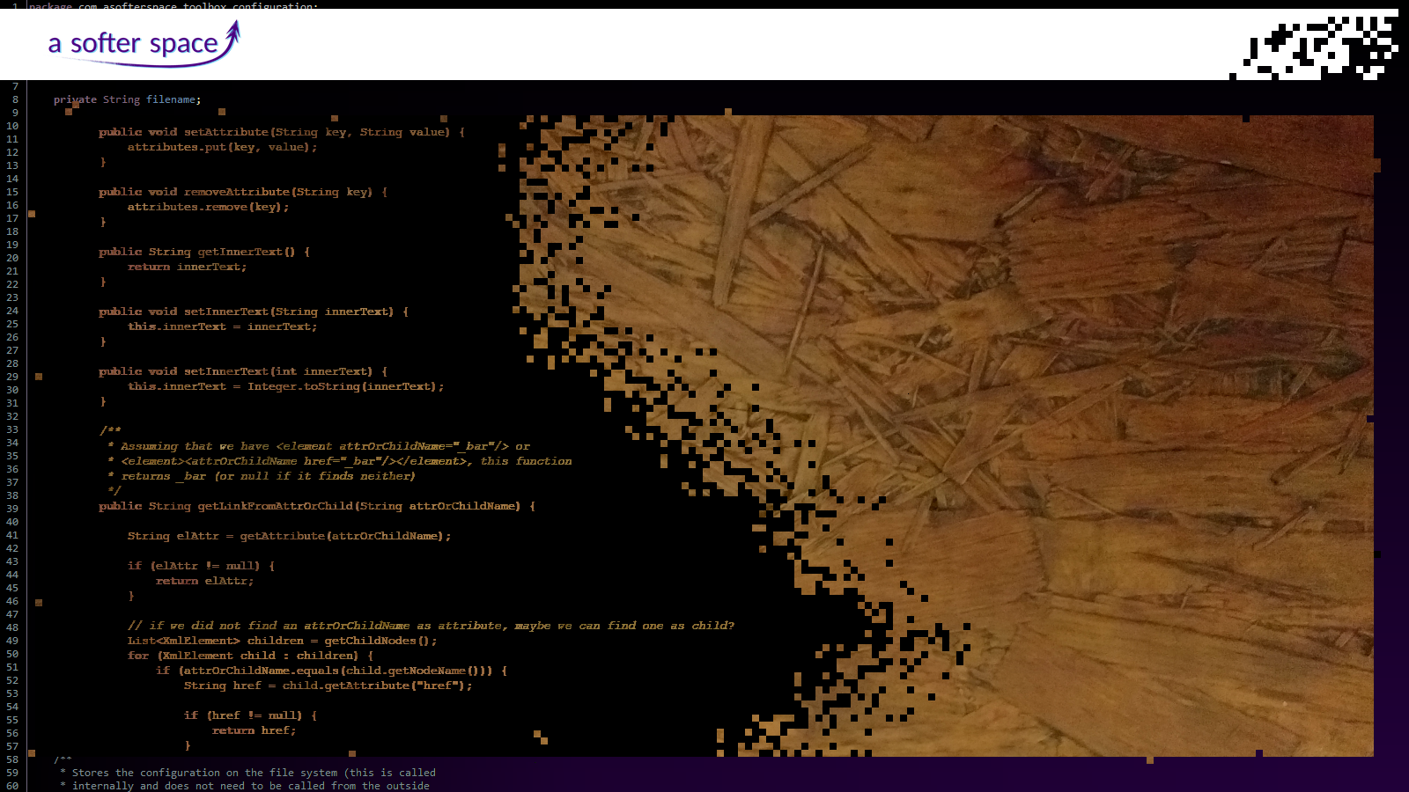
... but build reliable
“Software made from wood”
instead
... but build reliable
“Software made from wood”
instead
... but build reliable
“Software made from wood”
instead
... but build reliable
“Software made from wood”
instead
... but build reliable
“Software made from wood”
instead
... but build reliable
“Software made from wood”
instead
... but build reliable
“Software made from wood”
instead
... but build reliable
“Software made from wood”
instead
... but build reliable
“Software made from wood”
instead
... but build reliable
“Software made from wood”
instead
... but build reliable
“Software made from wood”
instead
... but build reliable
“Software made from wood”
instead
... but build reliable
“Software made from wood”
instead

Slide 17
We believe in open source software and are very intersted in projects in that direction
We are using agile processes to really deliver what you need

Slide 19
We juggle:
Firm technical requirements
Future extensibility of the software
Spontaneous changes of the plan
We juggle:
Firm technical requirements
Future extensibility of the software
Spontaneous changes of the plan
We juggle:
Firm technical requirements
Future extensibility of the software
Spontaneous changes of the plan
We juggle:
Firm technical requirements
Future extensibility of the software
Spontaneous changes of the plan
We juggle:
Firm technical requirements
Future extensibility of the software
Spontaneous changes of the plan
We juggle:
Firm technical requirements
Future extensibility of the software
Spontaneous changes of the plan
We juggle:
Firm technical requirements
Future extensibility of the software
Spontaneous changes of the plan
We juggle:
Firm technical requirements
Future extensibility of the software
Spontaneous changes of the plan
We juggle:
Firm technical requirements
Future extensibility of the software
Spontaneous changes of the plan
We juggle:
Firm technical requirements
Future extensibility of the software
Spontaneous changes of the plan
We juggle:
Firm technical requirements
Future extensibility of the software
Spontaneous changes of the plan
We juggle:
Firm technical requirements
Future extensibility of the software
Spontaneous changes of the plan
We juggle:
Firm technical requirements
Future extensibility of the software
Spontaneous changes of the plan

Slide 20
And most importantly...

Slide 21
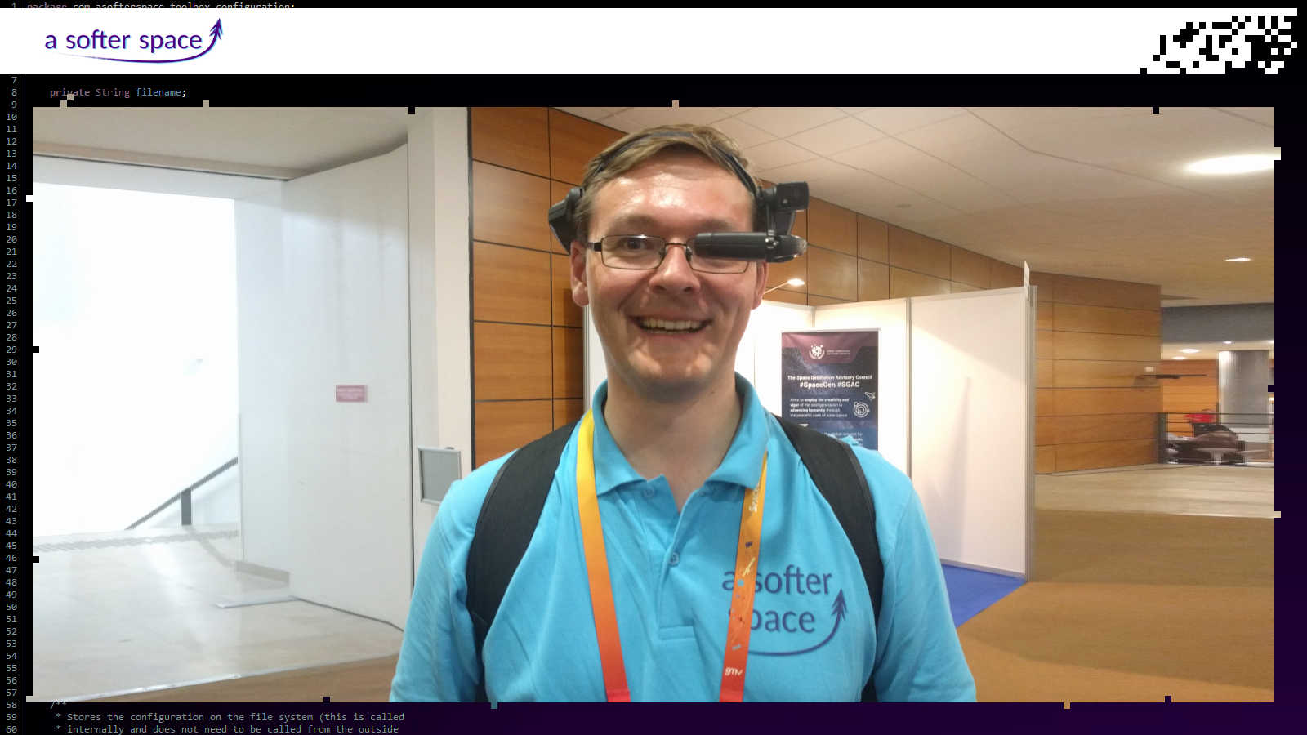

Slide 22
We are having
fun shaping
the future!
We are having
fun shaping
the future!
We are having
fun shaping
the future!
We are having
fun shaping
the future!
We are having
fun shaping
the future!
We are having
fun shaping
the future!
We are having
fun shaping
the future!
We are having
fun shaping
the future!
We are having
fun shaping
the future!
We are having
fun shaping
the future!
We are having
fun shaping
the future!
We are having
fun shaping
the future!
We are having
fun shaping
the future!

Slide 23
Are you game?

Slide 24
